Slide 1

List Comprehension, Maps
& Filters
By Shikha Singh

Slide 2
LIST COMPREHENSION
Lists in Python:
Lists are used to store multiple items in a single variable.
They are one of the built-in data types in Python used to store collections of data.
Lists are created using square brackets:
Example:
this_list = ["apple", "banana", "cherry"]
List items are ordered, changeable, and allow duplicate values.
List items are indexed, the first item has index [0], the second item has index [1] etc.
(Refer Jupyter notebook to view code samples)

Slide 3
List Comprehension
A Python list comprehension consists of brackets containing the expression, which is executed for each element along with the for loop to iterate over each element in the Python list.
List comprehension offers a shorter syntax when you want to create a new list based on the values of an existing list.
Advantages of List Comprehension:
More time-efficient and space-efficient than loops.
Require fewer lines of code.
Transforms iterative statement into a formula.

Slide 4
Suppose, we want to separate the letters of the word ‘human’ and add the letters as items of a list. The first thing that comes in mind would be using for loop:
h_letters = []
for letter in 'human':
h_letters.append(letter)
print(h_letters)
Output:
[‘h’, ‘u’, ‘m’, ‘a’, ‘n’]

Slide 5
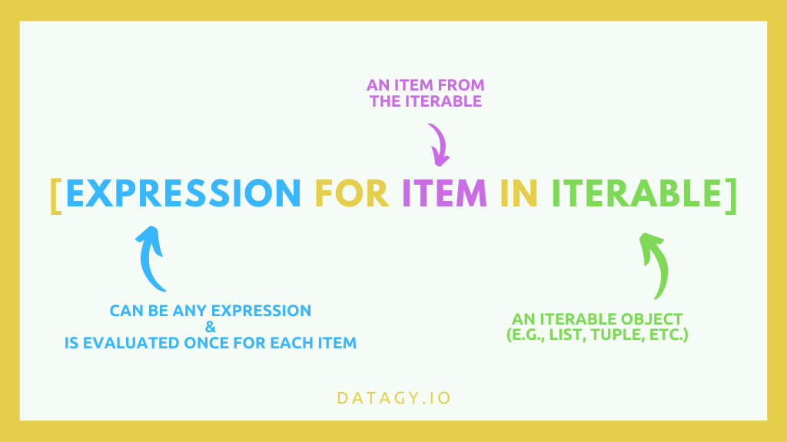
However, Python has an easier way to solve this issue using List Comprehension. List comprehension is an elegant way to define and create lists based on existing lists.
Let’s see how the above program can be written using list comprehensions.
h_letters = [ letter for letter in 'human' ]
print( h_letters)
Syntax:

Slide 6
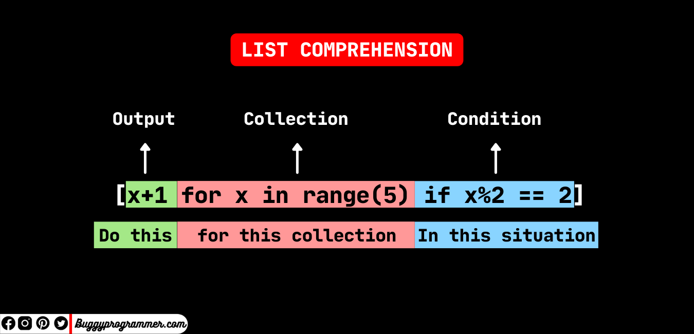

Slide 7
Nested List Comprehension

Slide 8
Nested List Comprehension
Since list comprehensions take a list as input and produce a list as output, they are easily nested.
→ li = [3, 2, 4, 1]
→ [element * 2 for element in [ item + 1 for item in li] ]
→ The inner comprehension is executed first producing:
[ item + 1 for item in li] gives:
3 + 1 = 4 2 + 1 = 3 4 + 1 = 5 1 + 1 = 2 giving: [4, 3, 5, 2]
→ Now, the outer list comprehension works on the resultant list received the inner list comprehension:
→ [element * 2 for element in [output_list_from_inner_list_comprehension] ] gives:
4 * 2 = 8 3 * 2 = 6 5 * 2 = 10 2 * 2 = 4 giving: [8, 6, 10, 4]
Result: [8, 6, 10, 4]

Slide 9
MAP() IN PYTHON
Map applies function to each element of iterable (list, tuple, etc.) and creates a list of the results.
We can optionally provide more iterables as parameters to map and it will place tuples in the result list.
Syntax:
map(function, iter)
Parameters:
function: It is a function to which map passes each element of given iterable
iter: It is the iterable which is to be mapped

Slide 10
MAPS IN PYTHON
NOTE : We can pass one or more iterable to the map() function.
Function
Map
Iterable

Slide 11
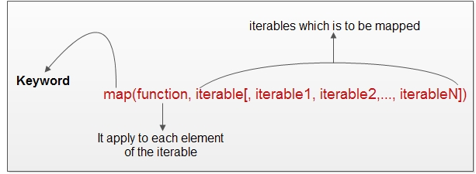

Slide 12
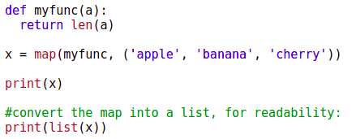

Code Example
Output:

Slide 13
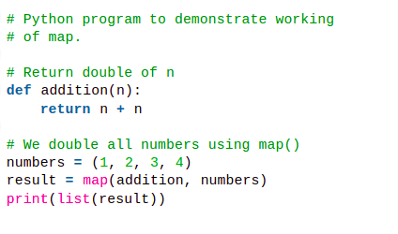
Code Example
Output:
[2, 4, 6, 8]

Slide 14
FILTER() IN PYTHON
The filter() method filters the given sequence with the help of a function that tests each element in the sequence to be true or not.
Syntax:
filter(function, sequence)
Parameters:
function: function that tests if each element of a sequence is true or not.
sequence: sequence which needs to be filtered, it can be sets, lists, tuples, or containers of any iterators.
Returns: returns an iterator that is already filtered.

Slide 15
FILTER() IN PYTHON
Function
Filter
Iterable

Slide 16
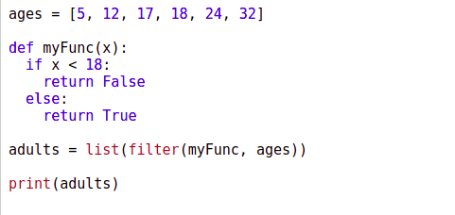
Code Example
Output: [18, 24, 32]

Slide 17
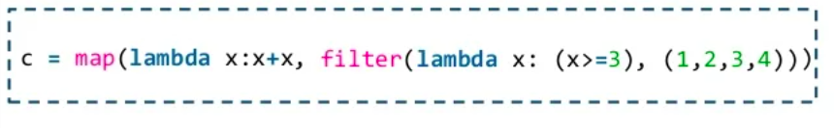
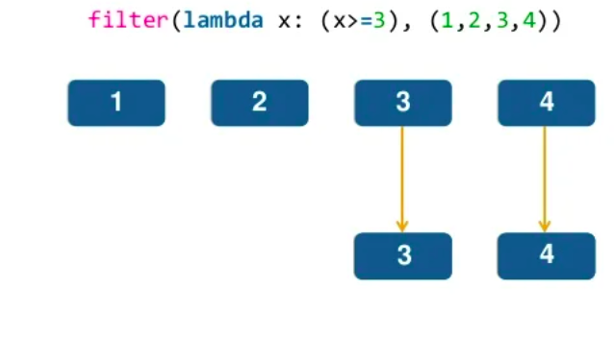
filter() within map()

Slide 18
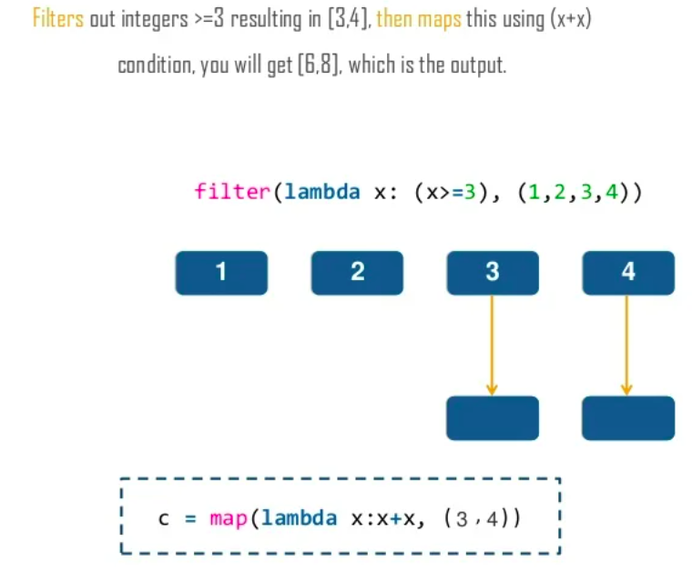

Slide 19

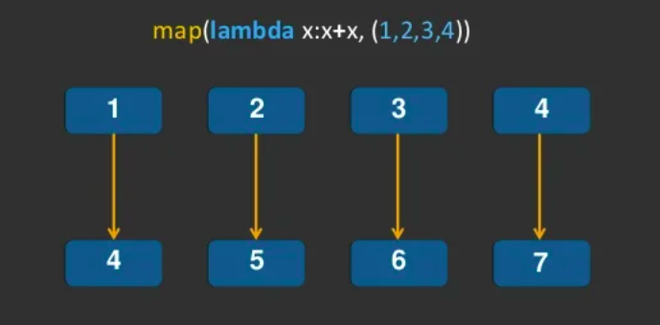
map() within filter()

Slide 20
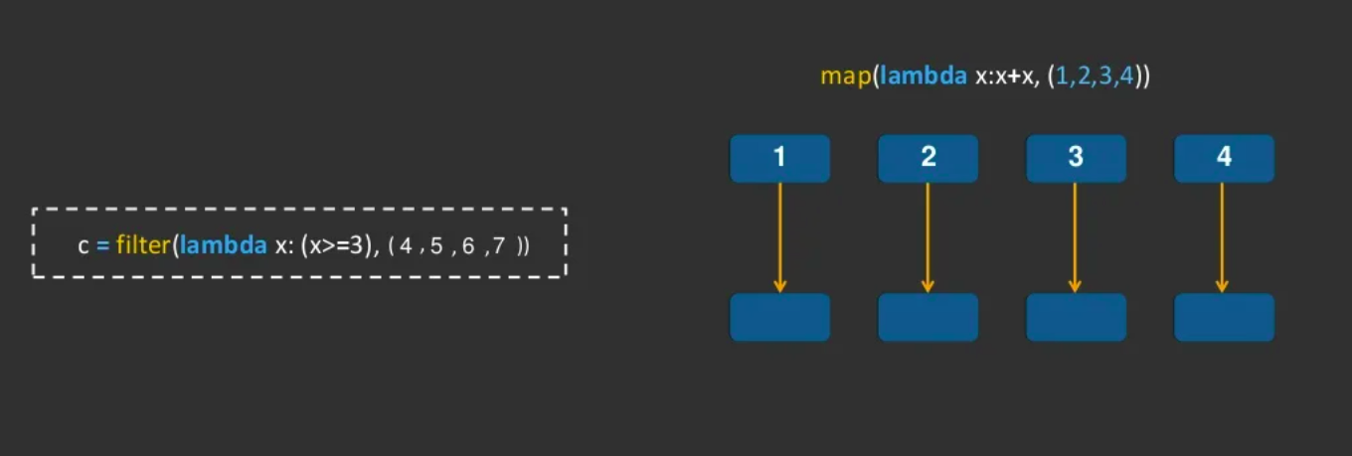

Slide 21
THANK YOU!

